Slide 1


Parallel and Distributed Systems / 1
Pavel Krömer, Dept. of Computer Science, VSB – Technical University of Ostrava

Slide 2
Agenda
Course introduction and organization
Motivation
Basic concepts of parallelism

Slide 3
Introduction

Slide 4

Contact
Location
office: FEI EA444
office hours: per e-mail/phone
office phone: +420597325898
E-communication
pavel.kromer@vsb.cz
fei-pds2021.slack.com
homel.vsb.cz/~kro080/PDS-2021/
Seminars
PK

Slide 5
Course objectives
Introduction to the basic concepts of parallel and distributed platforms and algorithms
full range of parallel architectures (edge, multicore, distributed (HPC), cloud, edge and fog)
Working knowledge of basic parallel algorithms and parallelization strategies
methods to solve computationally extensive problems from different application areas
Practical introduction of selected parallel languages / language extensions
practical development of parallel codes

Slide 6
Credit
Agreed seminar project on an assigned topic
list of indicative themes will be available beginning March
each topic individually approved with instructor
Deadline
end of the credit week
Q.U.E.S.T.I.O.N.S

Slide 7
Motivation

Slide 8
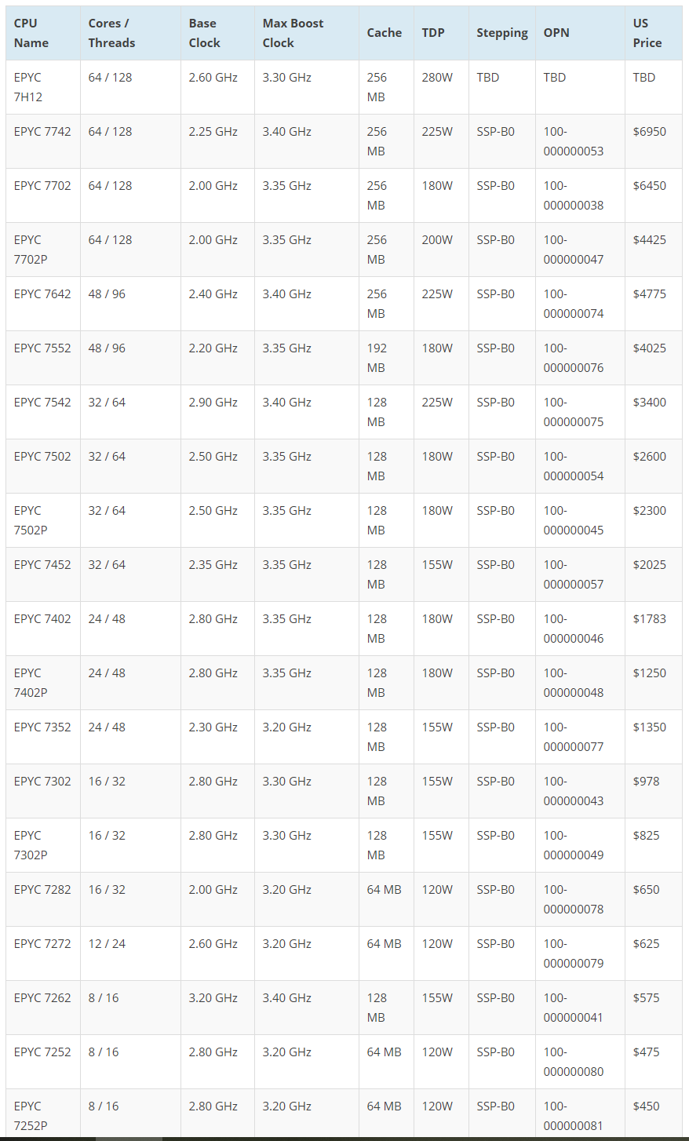

Course objectives
AMD 7nm EPYC Rome
EPYC 7H12, announced 7. 8. 2019
7nm Zen 2 core architecture
64 cores and 128 threads
2.60 GHz / 3.30 GHz, 256 MB L3 cache
designed for liquid-cooled spaces
adopted by Google in late 2019
AMD 7nm EPYC Milan
T.B.R. late 2020
7+ nm, up to 64 Zen 3 cores

Slide 9
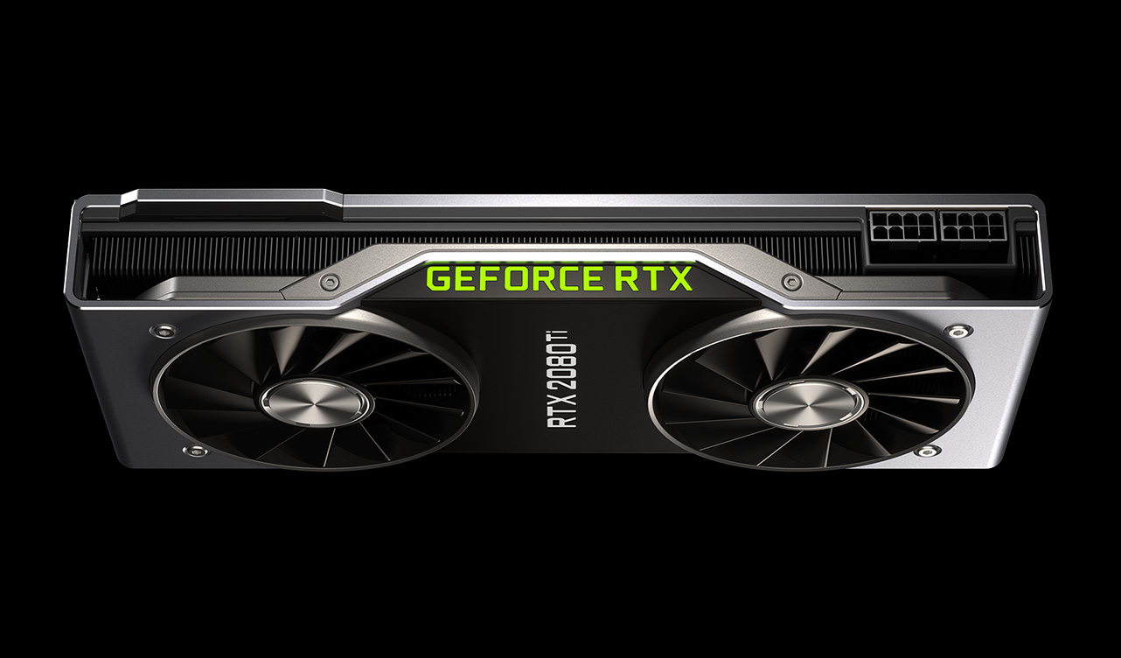
TESLA V100 Tensor Core GPU
5,120 CUDA cores; 640 Tensor cores; 32GB HDM2;
Deep learning: TensorFlow, PyTorch, theano, Caffe2; Applications: OpenFoam etc.
RTX 2080 Ti
4,352 CUDA cores; 544 Tensor cores; 11GB of GDDR6
TITAN RTX
4,608 CUDA cores; 576 Tensor cores; 24 GB GDDR6; NVIDIA’s CUDA-X AI SDK; 70,000 CZK on Alza.cz (2019)

Slide 10
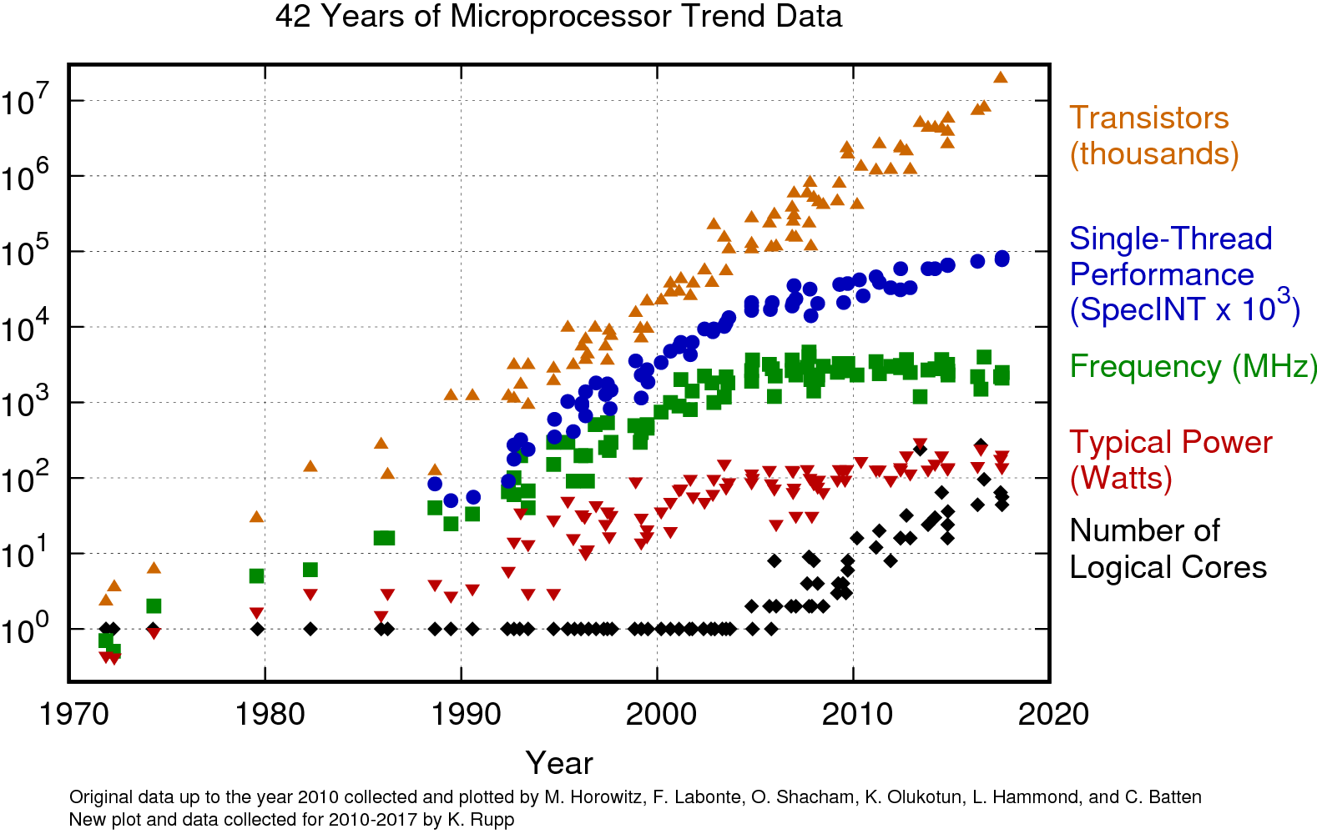

Slide 11
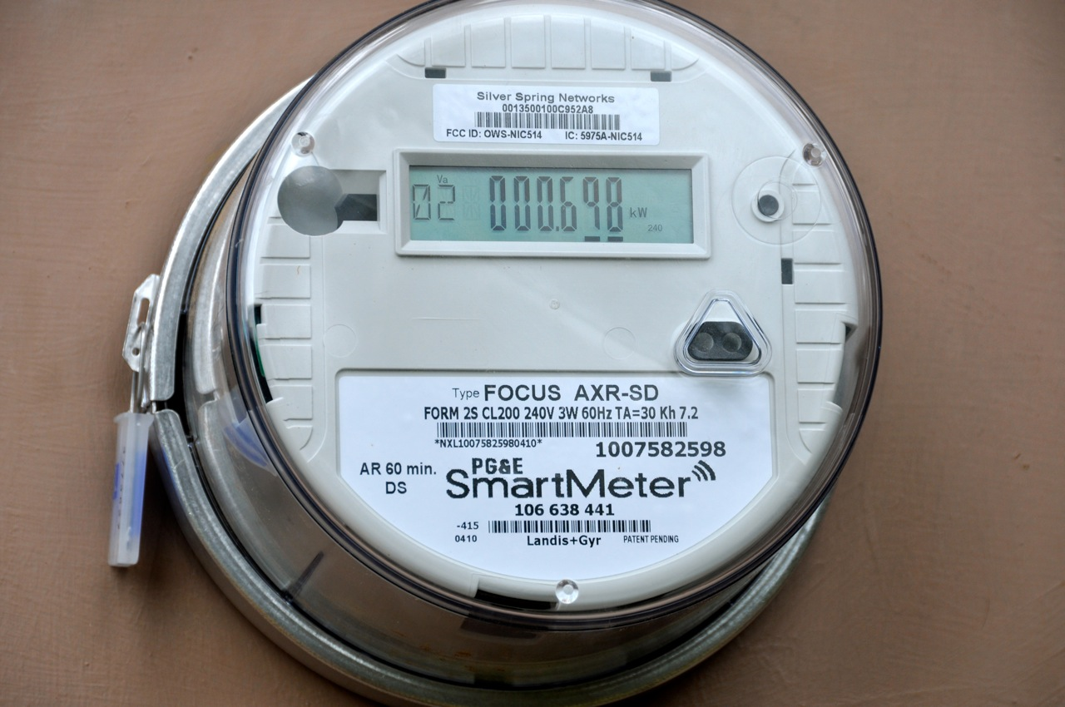
Edge and Fog computing
Fog computing pushes intelligence down to the local area network level of network architecture, processing data in a fog node or IoT gateway.
Edge computing pushes the intelligence, processing power and communication capabilities of an edge gateway or appliance directly into devices like programmable automation controllers (PACs)
Typical applications
Intelligent Transportation Management (ITS)
Industrial & Commercial Networking
Smart Metering for Utilities
Autonomous Vehicles

Slide 12
Parallelism and Concurrency

Slide 13

Multiprocessing and multithreading
Multitasking OS
Allows the execution of more than one process (computer programme + resources in memory) at a time
The number of tasks can exceed the number of physical cores / threads
Multitasking OS has all the components necessary to handle this situation by task switching

Slide 14
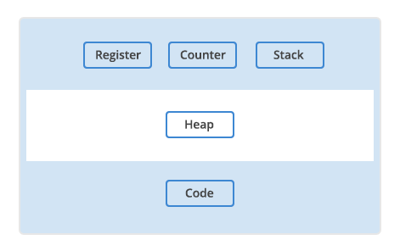
Multiprocessing and multithreading
Process
runnable software is in the process model organized into sequential processes
a running program, including the current values of the program counter, registers, and variables. It has a virtual CPU and shares physical CPU(s) via task-switching
processes are independent (isolated by the OS) and communicate via inter-process communication (IPC)
Task-switching
when more processes require a shared resource (CPU), fast task switching can give an illusion of parallelism (aka. pseudo-parallelism, concurrency)

Slide 15
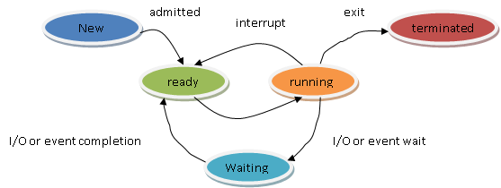
Multiprocessing and multithreading
Process states
a process can be in one of several internal states:
Running -> Waiting: process blocks for input
Waiting -> Ready: input becomes available
Ready -> Running: scheduler picks the process and allocates CPU
Running -> Ready: scheduler removes process from CPU
all is done according to a specific scheduling algorithm

Slide 16
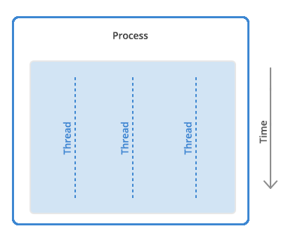
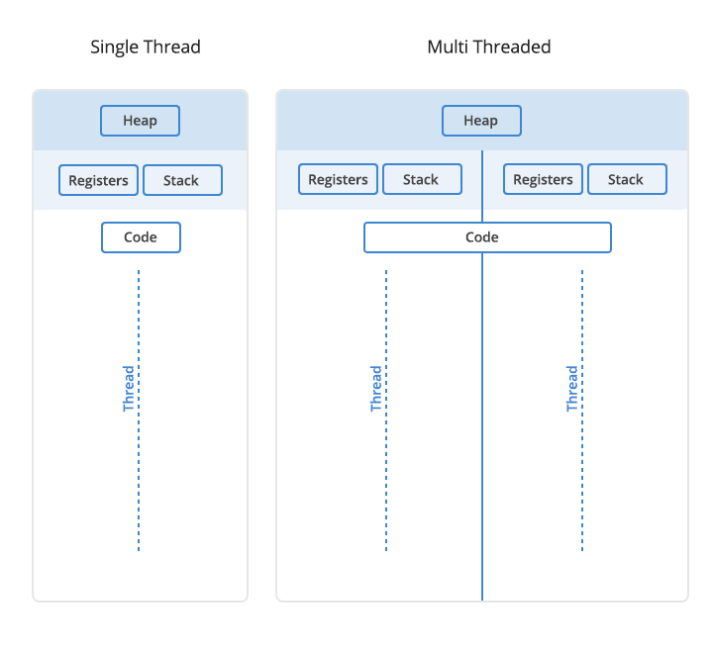
Multiprocessing and multithreading
Thread
a unit of (parallel) execution within a process (1-N)
each thread in a process shares its resources (that makes them more lightweight)
communication between threads is cheaper than IPC
problem of one thread can easily affect other threads, too (and the whole process might have to be killed)
Properties
each thread has its own program counter, registers, stack
and shares data space, address space, resources (and limits)

Slide 17
Threads vs. processes
Process
Thread
Processes are heavyweight operations
Each process has its own memory space
Inter-process communication is slow as processes have different memory addresses
Context switching between processes is more expensive
Processes don’t share memory with other processes
Threads are lighter weight operations
Threads use the memory of the process they belong to
Inter-thread communication can be faster than inter-process communication because threads of the same process share memory with the process they belong to
Context switching between threads of the same process is less expensive
Threads share memory with other threads of the same process

Slide 18
Inter-process communication (IPC)
Communication between cooperating processes, preferably in a well-structured way and not using interrupts. It must deal with:
information passing,
clash of activities
dependencies
Usually implemented by
shared memory
message passing
-> pipes and named pipes; message queueing; semaphores; shared memory; and sockets
IPC concepts and issues
synchronization, critical regions, mutual exclusion, semaphores, mutexes, monitors, barriers
race conditions, deadlocks, busy waiting

Slide 19
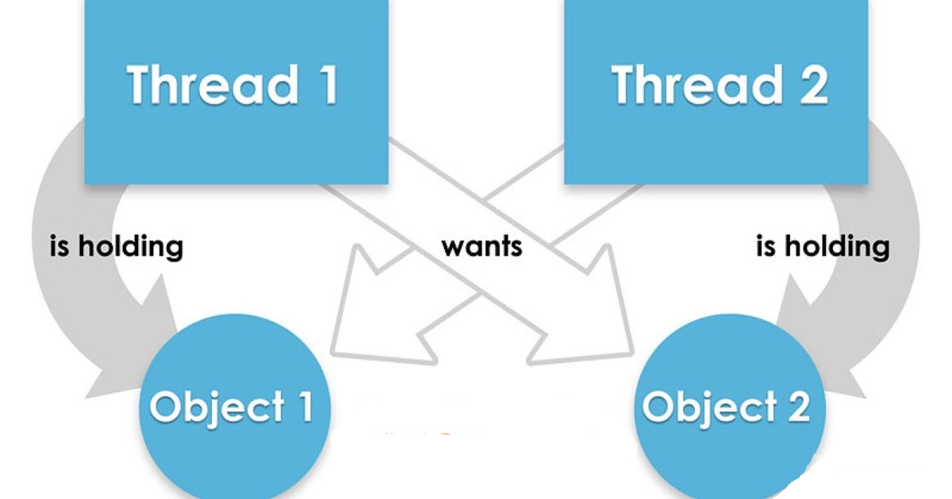
Inter-process communication (IPC)
Deadlocks
a set of processes is deadlocked if each process in the set is waiting for an event that only another process in the set can cause.
a situation in which one process, A, waits for a resource exclusively used by another process, B, which, in turn, waits for another resource owned by A. Both processes wait forever.
Conditions for a deadlock are:
mutual exclusion,
hold and wait,
no preemption, and
circular wait
Dealing with deadlocks:
do nothing
detection and recovery
avoidance by careful resource allocation
preventing (one) of the conditions for deadlock

Slide 20
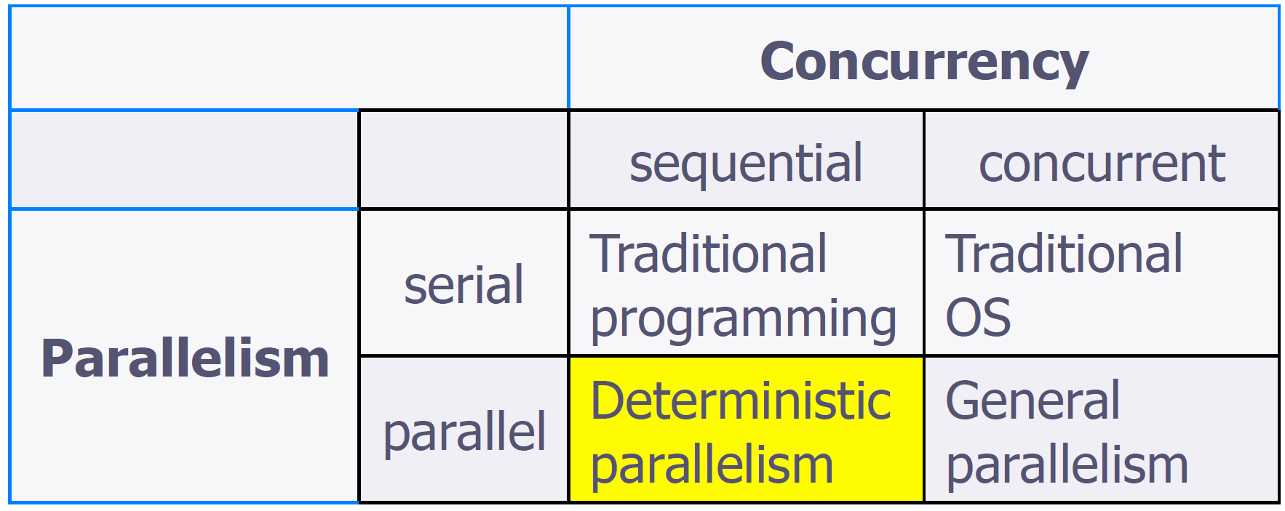
Parallelism vs. concurrency
Parallelism vs. concurrency
Parallelism: using multiple processors/cores running at the same time. Property of the machine (parallel machine).
Concurrency: non-determinacy due to interleaving threads. Property of the application (concurrent tasks).

Slide 21
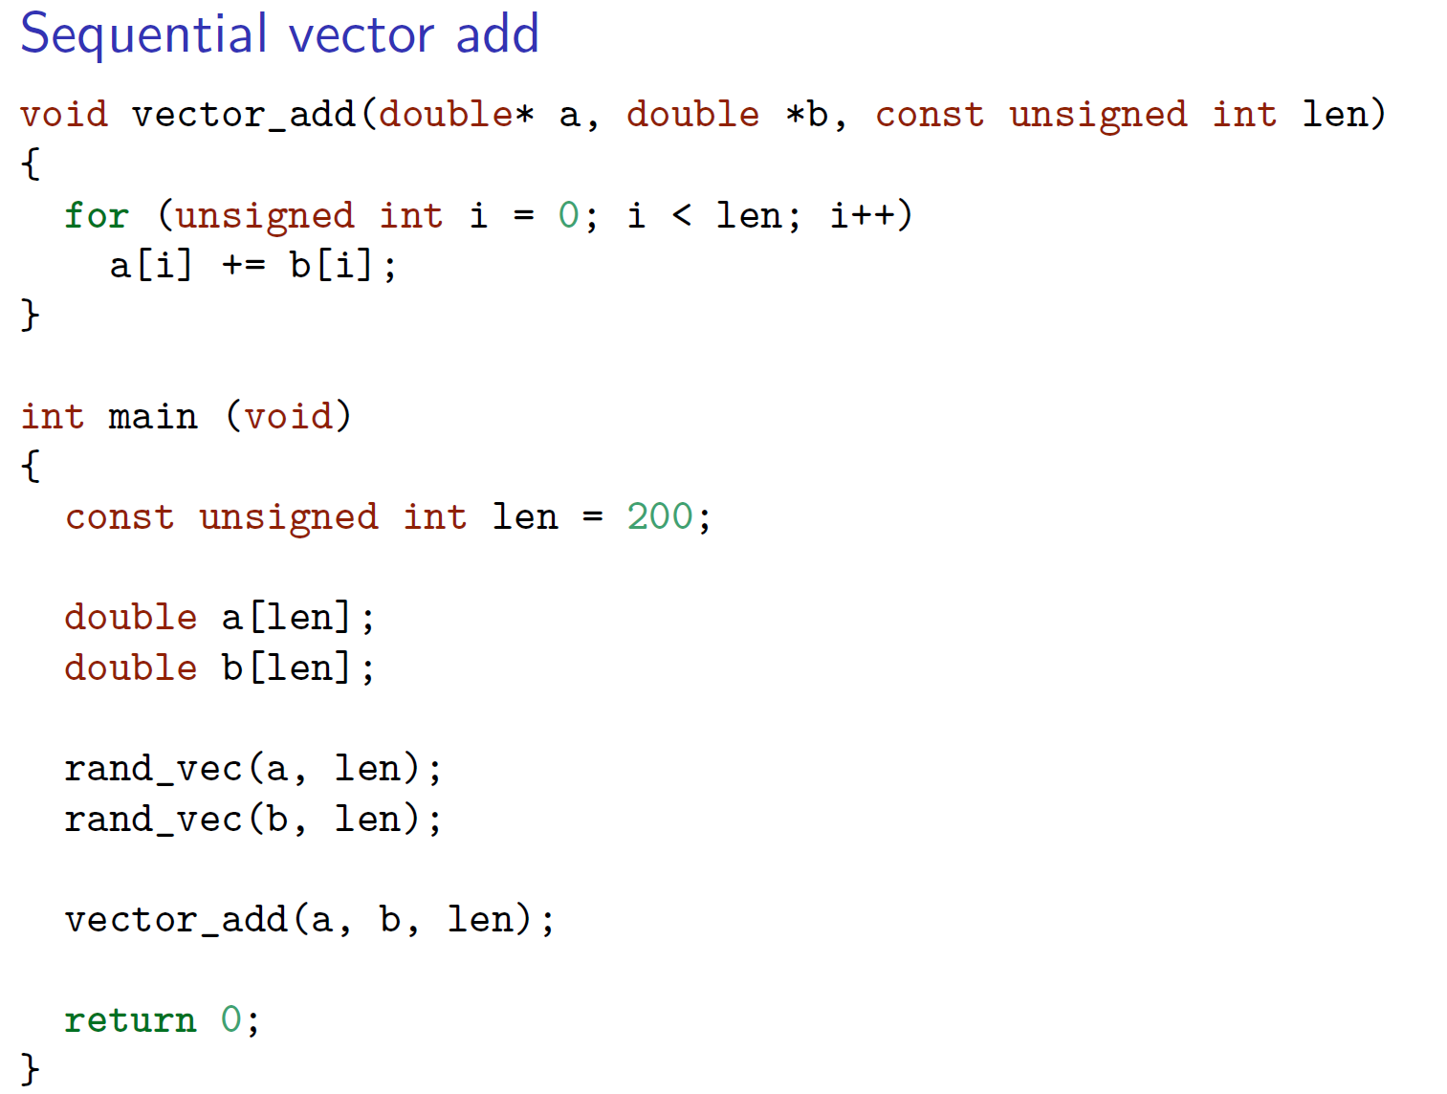
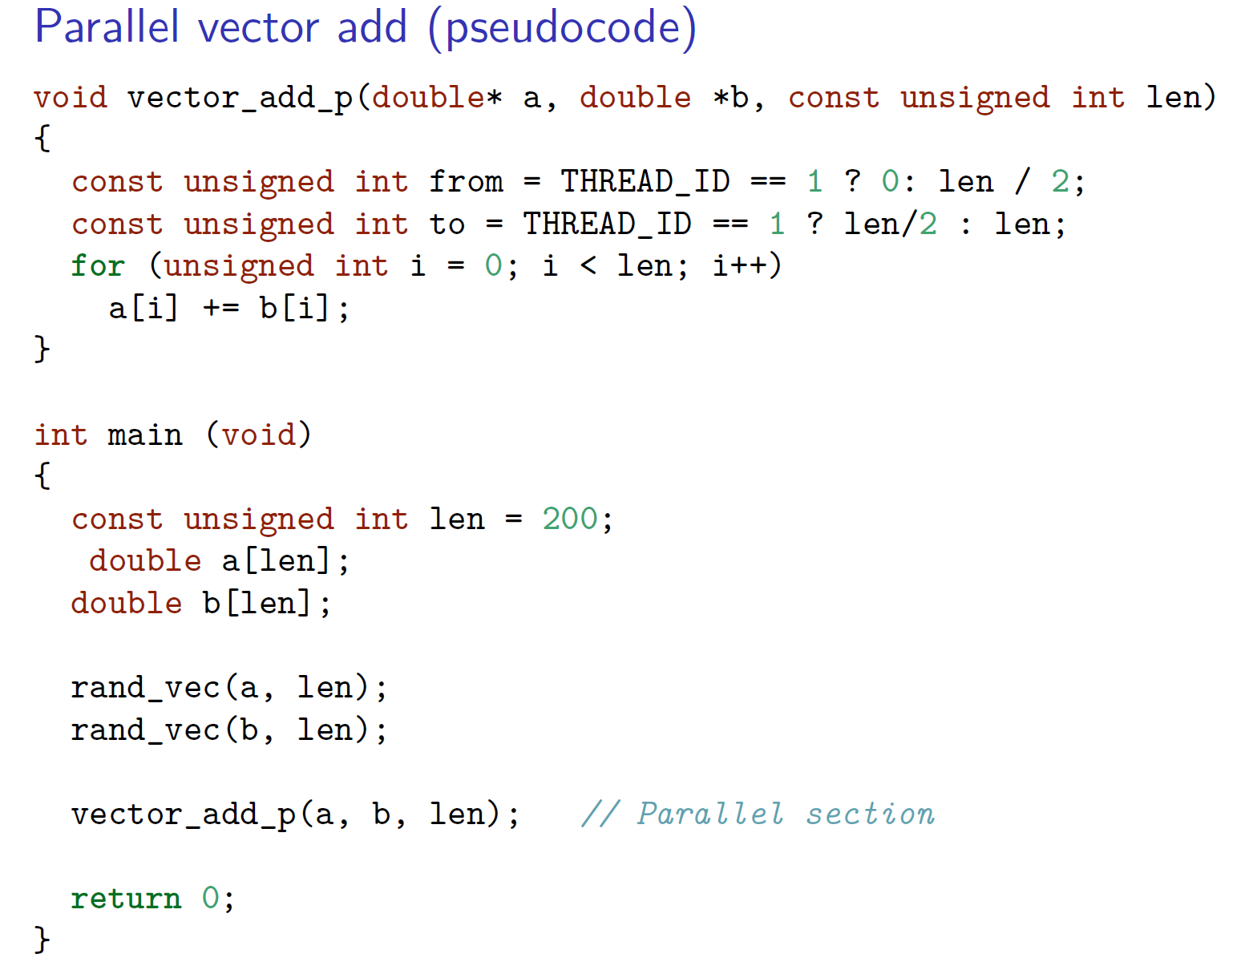
Parallel vs. sequential programme
Summary
parallel code is intuitive, but requires additional attention and
brings more challenges, including IPC, scalability, portability

Slide 22
Parallel vs. sequential programming
Summary
parallel code is intuitive*, but requires additional attention
brings more challenges, including IPC, scalability, portability
Parallel programming is a two-step process
design a work-efficient, low-span parallel algorithm
implement it on the target hardware
In reality: many systems require different code to implement the algorithm efficiently
huge effort to generate efficient portable parallel code.
* a manual implementation of Quicksort in MPI can be 1700 lines of code, and about the same in CUDA

Slide 23
Parallel vs sequential programming
Problem solving based on parallel thinking
Recognizing true dependences (cw. sequential programming)
Parallel algorithm design
operations on aggregates: map/reduce/scan
divide & conquer, contraction
viewing computation as DAG (based on dependences)

